Slide 1
Lecture 25
November 1st , 2019
  I will finish up fly crosses today and distribute vials to lab pairs. (These are the parental crosses). Next week we will need to clear out parent flies so as F1 emerge, we are not mistakenly analyzing parents or mating parents with F1.
  The next cross is easier as we basically take the F1 males and females and let them do their thing! The final analysis will be of the F2 offspring.

Slide 2
Where were we?…
  Conditionally expressed genotypes
  Sex-influenced traits
  Temperature-sensitive alleles
  Nutrition-sensitive alleles
  Variable onset of phenotypes
  Imprinting

Slide 3
Imprinting
e.g. For certain genes, expression of one allele may be shut down if inherited from one sex or the other.
    Expression is shut off as the allele is passed through egg or sperm during meiosis.
    Example on board…Dwarf phenotype in mice. Dwarfism in mice is recessive….What do you expect when you cross 2 mice who carry the recessive allele?
    ---cross 2 heterzygotes.

Slide 4
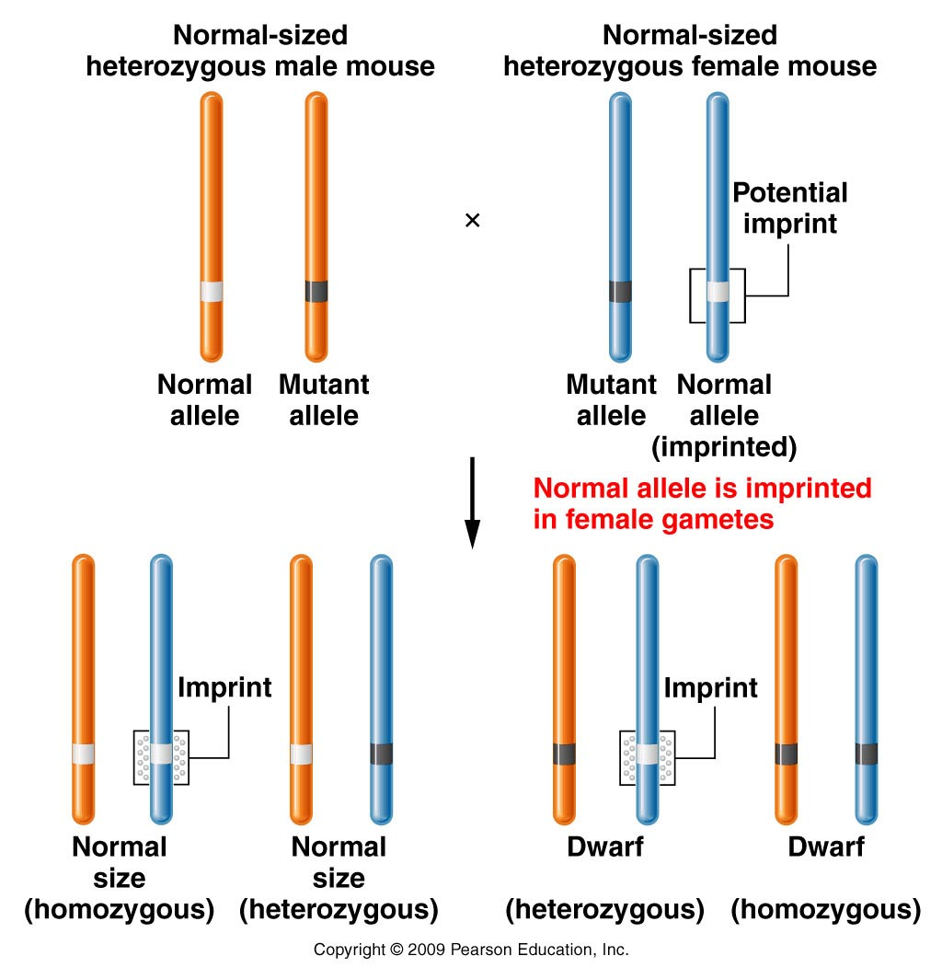
Figure 4.20
Notes:
4
Figure 4-20 The effect of imprinting on the mouse Igf2 gene, which produces dwarf mice in the homozygous condition. Heterozygous offspring that receive the normal allele from their father are normal in size. Heterozygotes that receive the normal allele from their mother, which has been imprinted, are dwarf.

Slide 5
Cross of wild-type heterozygotes
Not 3:1 ratio
Figure 4.20
Notes:
5
Figure 4-20 The effect of imprinting on the mouse Igf2 gene, which produces dwarf mice in the homozygous condition. Heterozygous offspring that receive the normal allele from their father are normal in size. Heterozygotes that receive the normal allele from their mother, which has been imprinted, are dwarf.

Slide 6
Why is this female normal sized?
Figure 4.20
Notes:
6
Figure 4-20 The effect of imprinting on the mouse Igf2 gene, which produces dwarf mice in the homozygous condition. Heterozygous offspring that receive the normal allele from their father are normal in size. Heterozygotes that receive the normal allele from their mother, which has been imprinted, are dwarf.

Slide 7
The imprinting of the allele occurs only when the female produces eggs. In all of her somatic cells, the allele is expressed normally.
Her eggs become her offspring. When the allele is inherited it remains imprinted in the offsprings’ somatic cells.

Slide 8
This offspring’s size is due to imprinting of the normal allele in all of his/her cells because it occurred in the eggs of the mother
Figure 4.20
Notes:
8
Figure 4-20 The effect of imprinting on the mouse Igf2 gene, which produces dwarf mice in the homozygous condition. Heterozygous offspring that receive the normal allele from their father are normal in size. Heterozygotes that receive the normal allele from their mother, which has been imprinted, are dwarf.

Slide 9
The allele can be “un-imprinted”. For example, it the dwarf mouse is male, the imprinting of the allele is reversed when the male makes sperm. In this case, imprinting is linked to female gamete formation.
(other imprinted genes, become imprinted in male gamete formation)

Slide 10
What is the molecular mechanism of imprinting? It appears to be on type of DNA modification called Methylation.

Slide 11
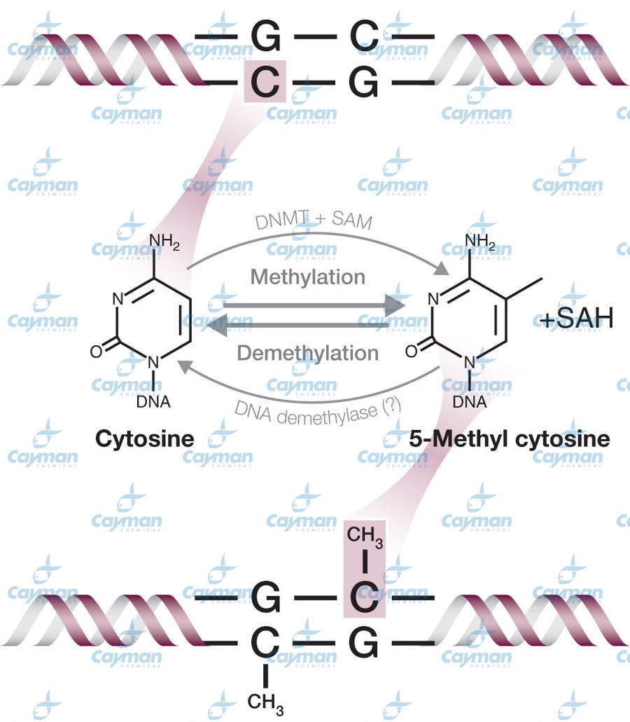
DNA methylation

Slide 12
Methylation is one mechanism involved in epigenetics
DNA methlyation is a common way of changing a gene without changing the DNA sequence (AGTC sequence) of the gene.
Methlyated DNA regions usually can’t be transcribed so genes are shut off in these regions. (like in the imprinted Dwarf gene)

Slide 13
Inactivation of the X-chromosome is also an example of epigenetics. And like imprinting by methylation, the X-inactivation method is reversible. When a female mammal makes eggs, she must be able to pass on active versions of her X chromosomes…
Explore this website.
http://learn.genetics.utah.edu/content/epigenetics/

Slide 14
New concept…
Sometimes, a rather complex set of abnormalities or a disease that might appear to be controlled by many genes.
The individual had many abnormalities affecting multiple organs or systems.
A collection of abnormalities is sometimes called a syndrome

Slide 15
Some “syndromes” can be attributed to alterations in a single gene.
  Marfan syndrome---autosomal dominant disorder
    Result of a mutation in the gene encoding a protein called fibrillin. Extremely important structural protein. Found throughout the body in connective tissue.
      Found in lens of eye, blood vessels, bones. So symptoms of this syndrome include lens dislocation, aortic aneurysm, long fragile bones..

Slide 16
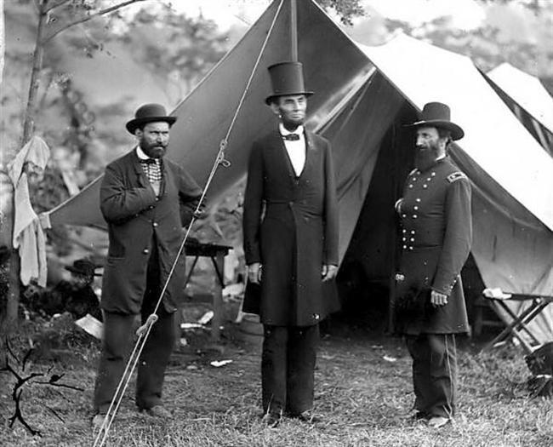
“Abe Lincoln phenotype”(Lincoln was once thought to have had Marfan syndrome, but further analysis indicates he did not.)

Slide 17
Affects ~1 in 5000 people
Abe Lincoln is not likely to have had Marfan syndrome, but some famous athletes are now know to have/have had it.
In some cases, it was not known until the early and sudden death of the person.

Slide 18
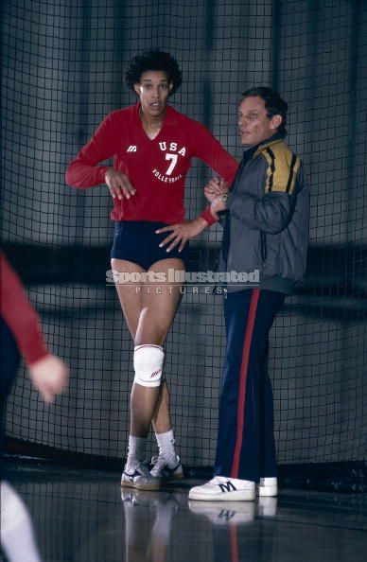
Flo Hyman, Olympic volleyball player for USA died at age 31 from an aorta tear, due to Marfan Syndrome.

Slide 19
When one gene alteration gives multiple phenotypes
  Lens tear
  Long limbs
  Weak aorta
  ---due to mutations in one gene:
  We refer to this as pleiotropy.

Slide 20
Let’s return to an extension we have already studied….
  Some traits are controlled by more than one gene.
  We looked at several 2-gene traits, and we looked at some polygenic /quantitative traits. But you’ve probably guessed that the complexity of living things might require that some traits are controlled by many genes—and that all the proteins involved in ”making the trait” are essential for that trait.
  If a phenotype is controlled by many genes, we might expect variation at any one of the genes to lead to variation in the phenotype. These traits can be difficult to figure out at the molecular level.

Slide 21
If all the gene products for a trait are essential…
…mutations in any of the genes involved might give the same phenotype.
  e.g. Consider hearing--- it depends on proper formation of ear (complex outer and inner structures), development of specific brain centers for interpreting sound, and neural connections between ear and brain. Gene mutations affecting any structure or mechanism related to hearing could give a phenotype of deafness.
Notes:
21

Slide 22
A side point….
Nearly everything we know about how things work in biology (and many disciplines) comes from studying organisms/situations in which something doesn’t work correctly— by observing an abnormality, a variant.
Most of the genes we know and understand were discovered by studying a disease or abnormality….which turned out to have a genetic basis…

Slide 23
When one is studying a suspected genetic variant/abnormality, the mutants may show one variation, but may reveal multiple genes are involved in producing the normal phenotype….
To determine the number of genes controlling a particular phenotype, we might use a genetic test called complementation analysis.
  Allows us to test whether two independently isolated mutants (same phenotype) are due to mutations in the same or in different genes.
  Each time we see a new/different gene, we can add it to the number of genes controlling the phenotype.
Notes:
23

Slide 24
Example…
You and a friend each find one fruit fly that lacks wings.
Since wing development likely involves dozens of different genes you wonder…are these mutants the result of mutations in the same gene or different genes?
Mate the flies and look at the offspring.
Notes:
24

Slide 25
Possible outcomes…
Offspring are wild-type (winged). Means the mutations covered or complemented each other. Each fly provided a wild-type of allele of the other’s mutation.
---Mutations must have been in different genes.

Slide 26
Offspring are still mutants (wingless). Means the mutations did not complement each other. The offspring fly received a mutant form of the same gene from each parent. They have the same genetic defect as the parent.
---Mutations must have been in same gene.
**mutations need not be exactly the same, but within the same gene, affecting the same gene product.

Slide 27
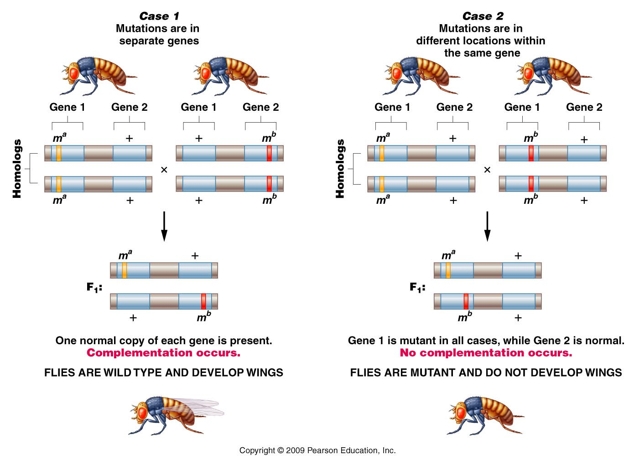
Figure 4.11
Notes:
27
Figure 4-11 Complementation analysis of alternative outcomes of two wingless mutations in Drosophila (mª and m^{b}). In Case 1, the mutations are not
alleles of the same gene, while in Case 2, the mutations are alleles of the same gene.

Slide 28
Figure 4.11
Notes:
28
Figure 4-11 Complementation analysis of alternative outcomes of two wingless mutations in Drosophila (mª and m^{b}). In Case 1, the mutations are not
alleles of the same gene, while in Case 2, the mutations are alleles of the same gene.

Slide 29
Important points!
The example makes it appear that genes for wing development would all be on the same chromosome….not true…just an easy way to show the concept…
**Complementation analysis only works for recessive traits!
Complementation analysis allows us to determine the number of genes involved in controlling a specific phenotype.
  # genes often referred to as # of complementation groups.

Slide 30
Chapter 5 – Linkage/Crossing over/ Chromosome mapping
We have spent much time studying one or a small number of genes contributing to specific traits:
  e.g. Isoagglutinogen gene---blood type

Slide 31
Of course each of our genes is located on a specific chromosome with many other genes physically linked to the same chromosome.

Slide 32
Who first described linkage…
Thomas Morgan---X-linked genes (white eye mutation).

Slide 33
Human chromosomes
23 different chromosomes
  Human Genome Project sequenced each of them. Estimate ~20,000-30,000 protein coding genes
  Average ~1300 genes/chromosome

Slide 34
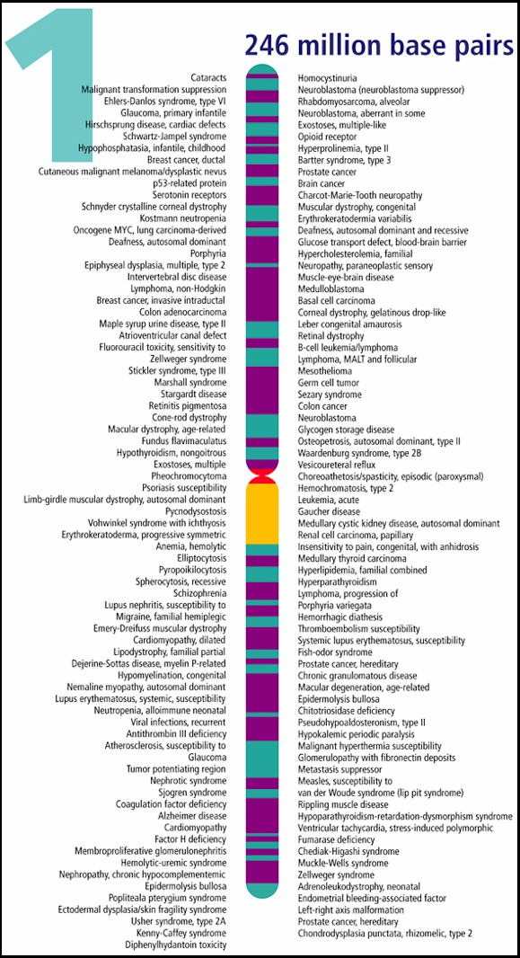
Example---genes mapped to chromosome 1

Slide 35
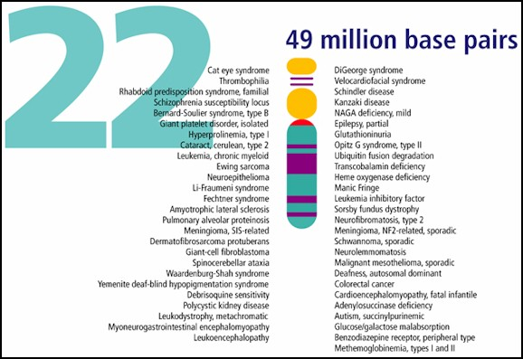
Genes mapped to human chromosome 22

Slide 36
Let’s begin by comparing independently assorting genes with linked genes
  Familiar example: color and texture in corn kernels
  Yellow (aa) sweet (bb)
  vs vs.
  Purple (A_) Starchy (B_)

Slide 37
In our lab we assumed 2 unlinked genes controlled these 2 traits
F2 offspring showed classic ratio of independent assortment
9 A_B_ Purple/starchy
3 A_bb Purple /sweet
3 aaB_ yellow/starchy
1 aabb yellow/sweet

Slide 38
What if the A locus and B locus were on the same chromosome. What do you expect?
--on white board…

Slide 39
What if the A locus and B locus were on the same chromosome. What do you expect?
--on white board…Do cross of a heterozygote AaBb X AaBb
A
a
A
a
B
b
B
b

Slide 40
This is an example of complete linkage.
  Complete linkage is actually quite rare---Why?
    During gamete formation, alleles on homologous chromosomes can switch places during crossing over / recombination. In a sense 2 alleles can become separated from each other, but not by independently assorting.

